Slide 1
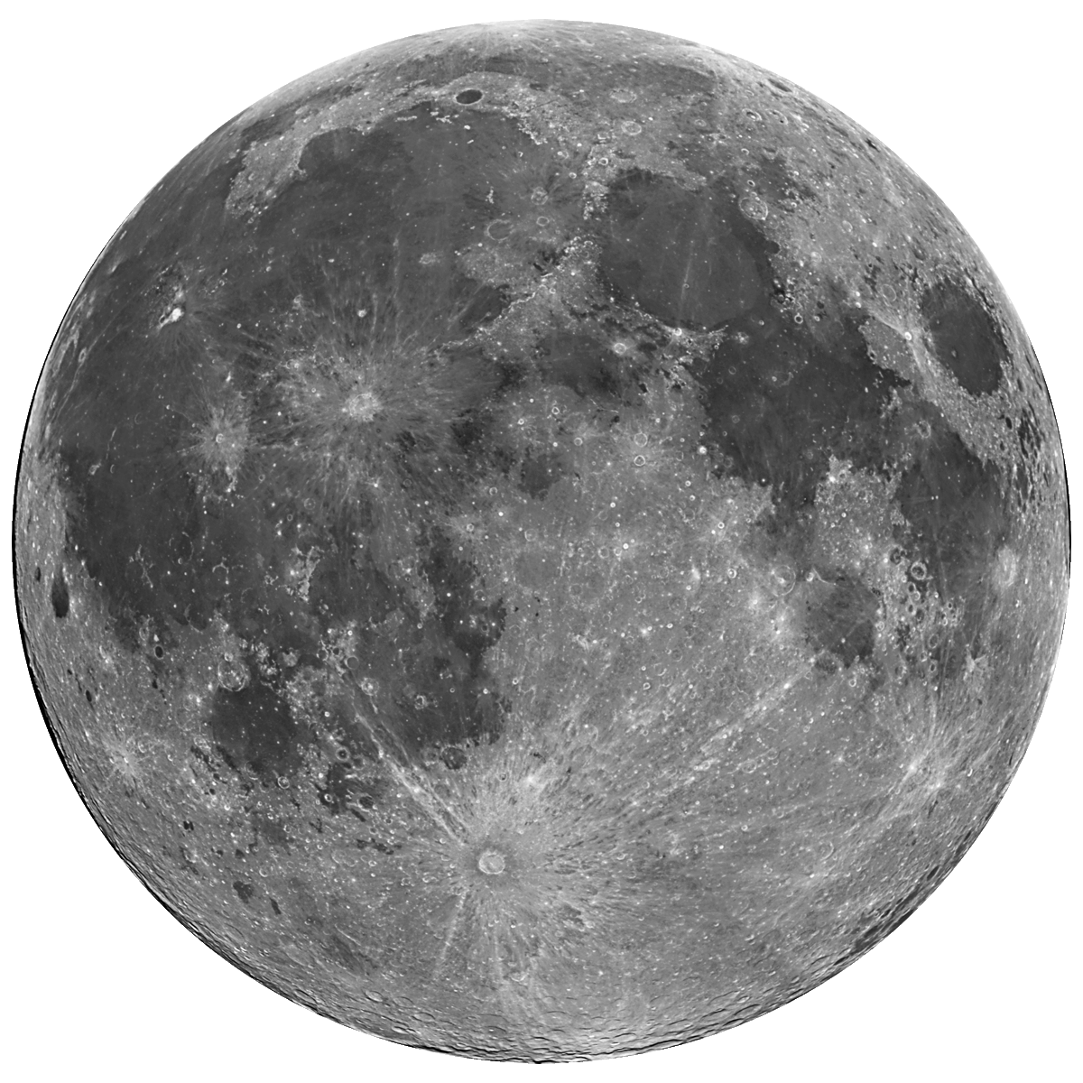
LUNAR INTERNET
OF THINGS
Emily Claros, Jarod Lopez, Julie Castro Pena, Samhith Marni

Slide 2
PROJECT OVERVIEW
GOAL: Build an Internet of Things (IoT) system for the lunar surface in collaboration with students from Rowan University and members of NASA’s Stennis Space Center.
Autonomous operations of lunar devices, enabling a rover to traverse the lunar surface in an efficient manner.
Establish communications between devices over an MQTT broker, allowing for the reception and analysis of data (i.e. battery station power levels).
Real time data processing to enable decision making, allowing rover to determine the most optimal path between objectives and battery stations.
Minimal human interaction in the operation of assets on the lunar surface
ROLES:
Emily (PM): Rover Digital Twin, Rover/Battery Test Simulation
Jarod (PM): Computer Vision, Communications
Julie: Space ROS & Pathmaking, Rover Digital Twin
Samhith: Space ROS & Pathmaking, Rover/Battery Test Simulation
Lekh: Communications, Project Consultant
Notes:
JAROD
IoT is a system of devices or objects with software and other technologies that enable the communication of data to other devices via the internet.

Slide 3
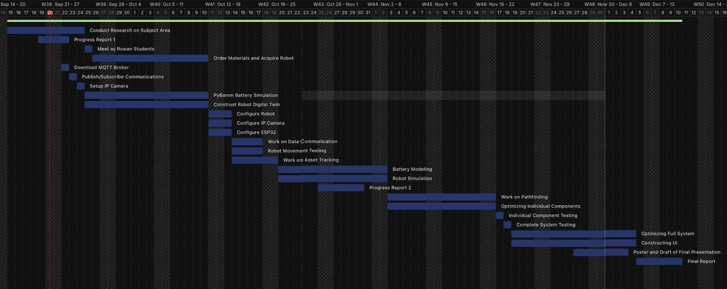
GANTT CHART
Notes:
EMILY
Will we be on track?: All milestones established in the Gantt chart have been met, and the project is on track for successful completion.

Slide 4
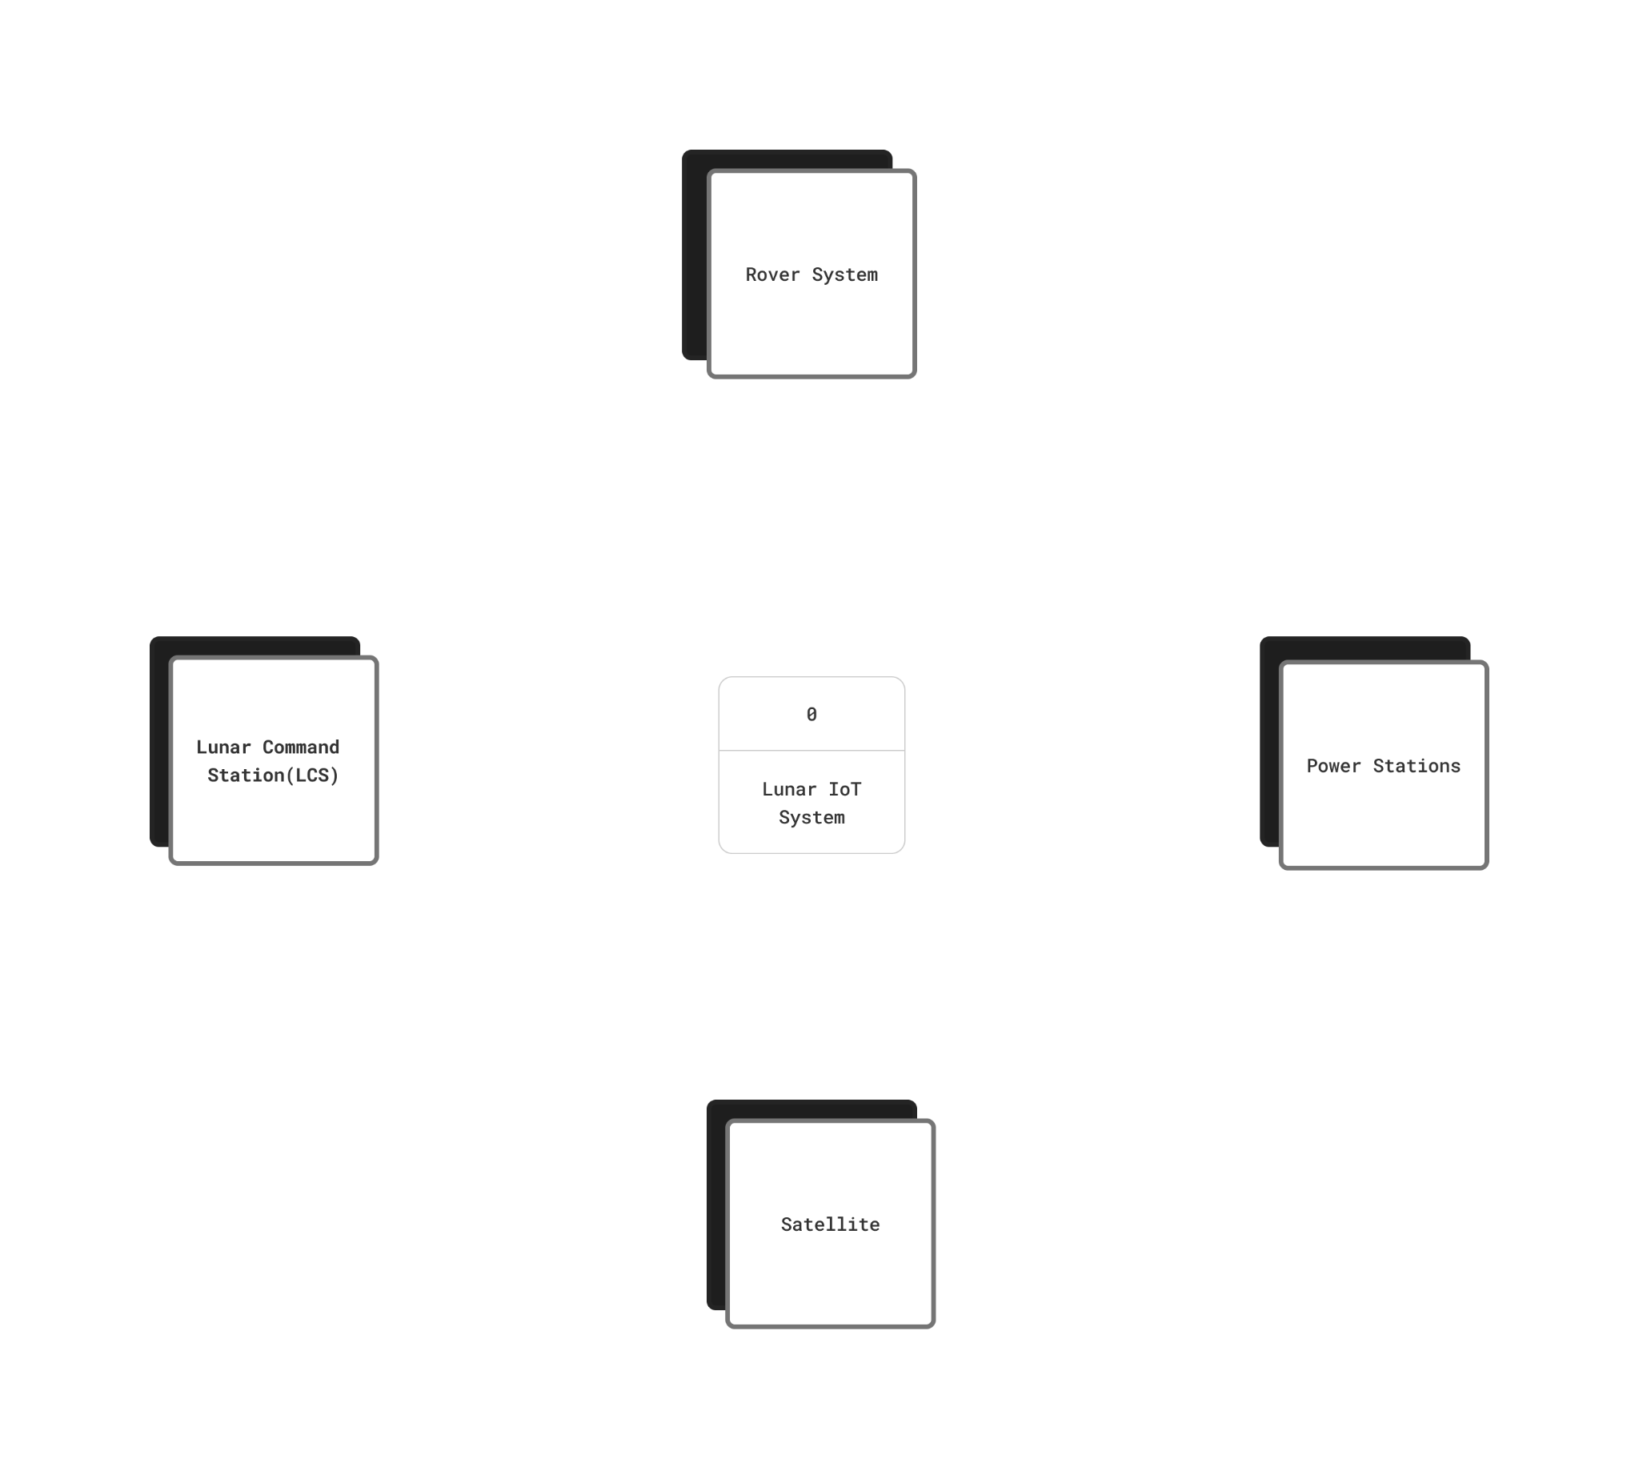
CONTEXT
DIAGRAM
Notes:
JAROD

Slide 5
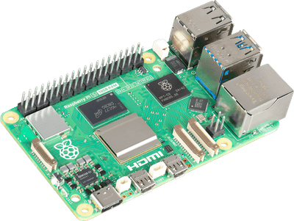
MATERIALS
Hardware:
MicroROS rover
Power banks
Raspberry Pi
Memory cards
LEDs, resistors, and jumper wires
Servo motors
ESP32 development board
Cameras
Software:
Space ROS
Unity
Autodesk Fusion360
Cesium
OpenCV
MQTT Servers/Brokers
Notes:
JULIE

Slide 6
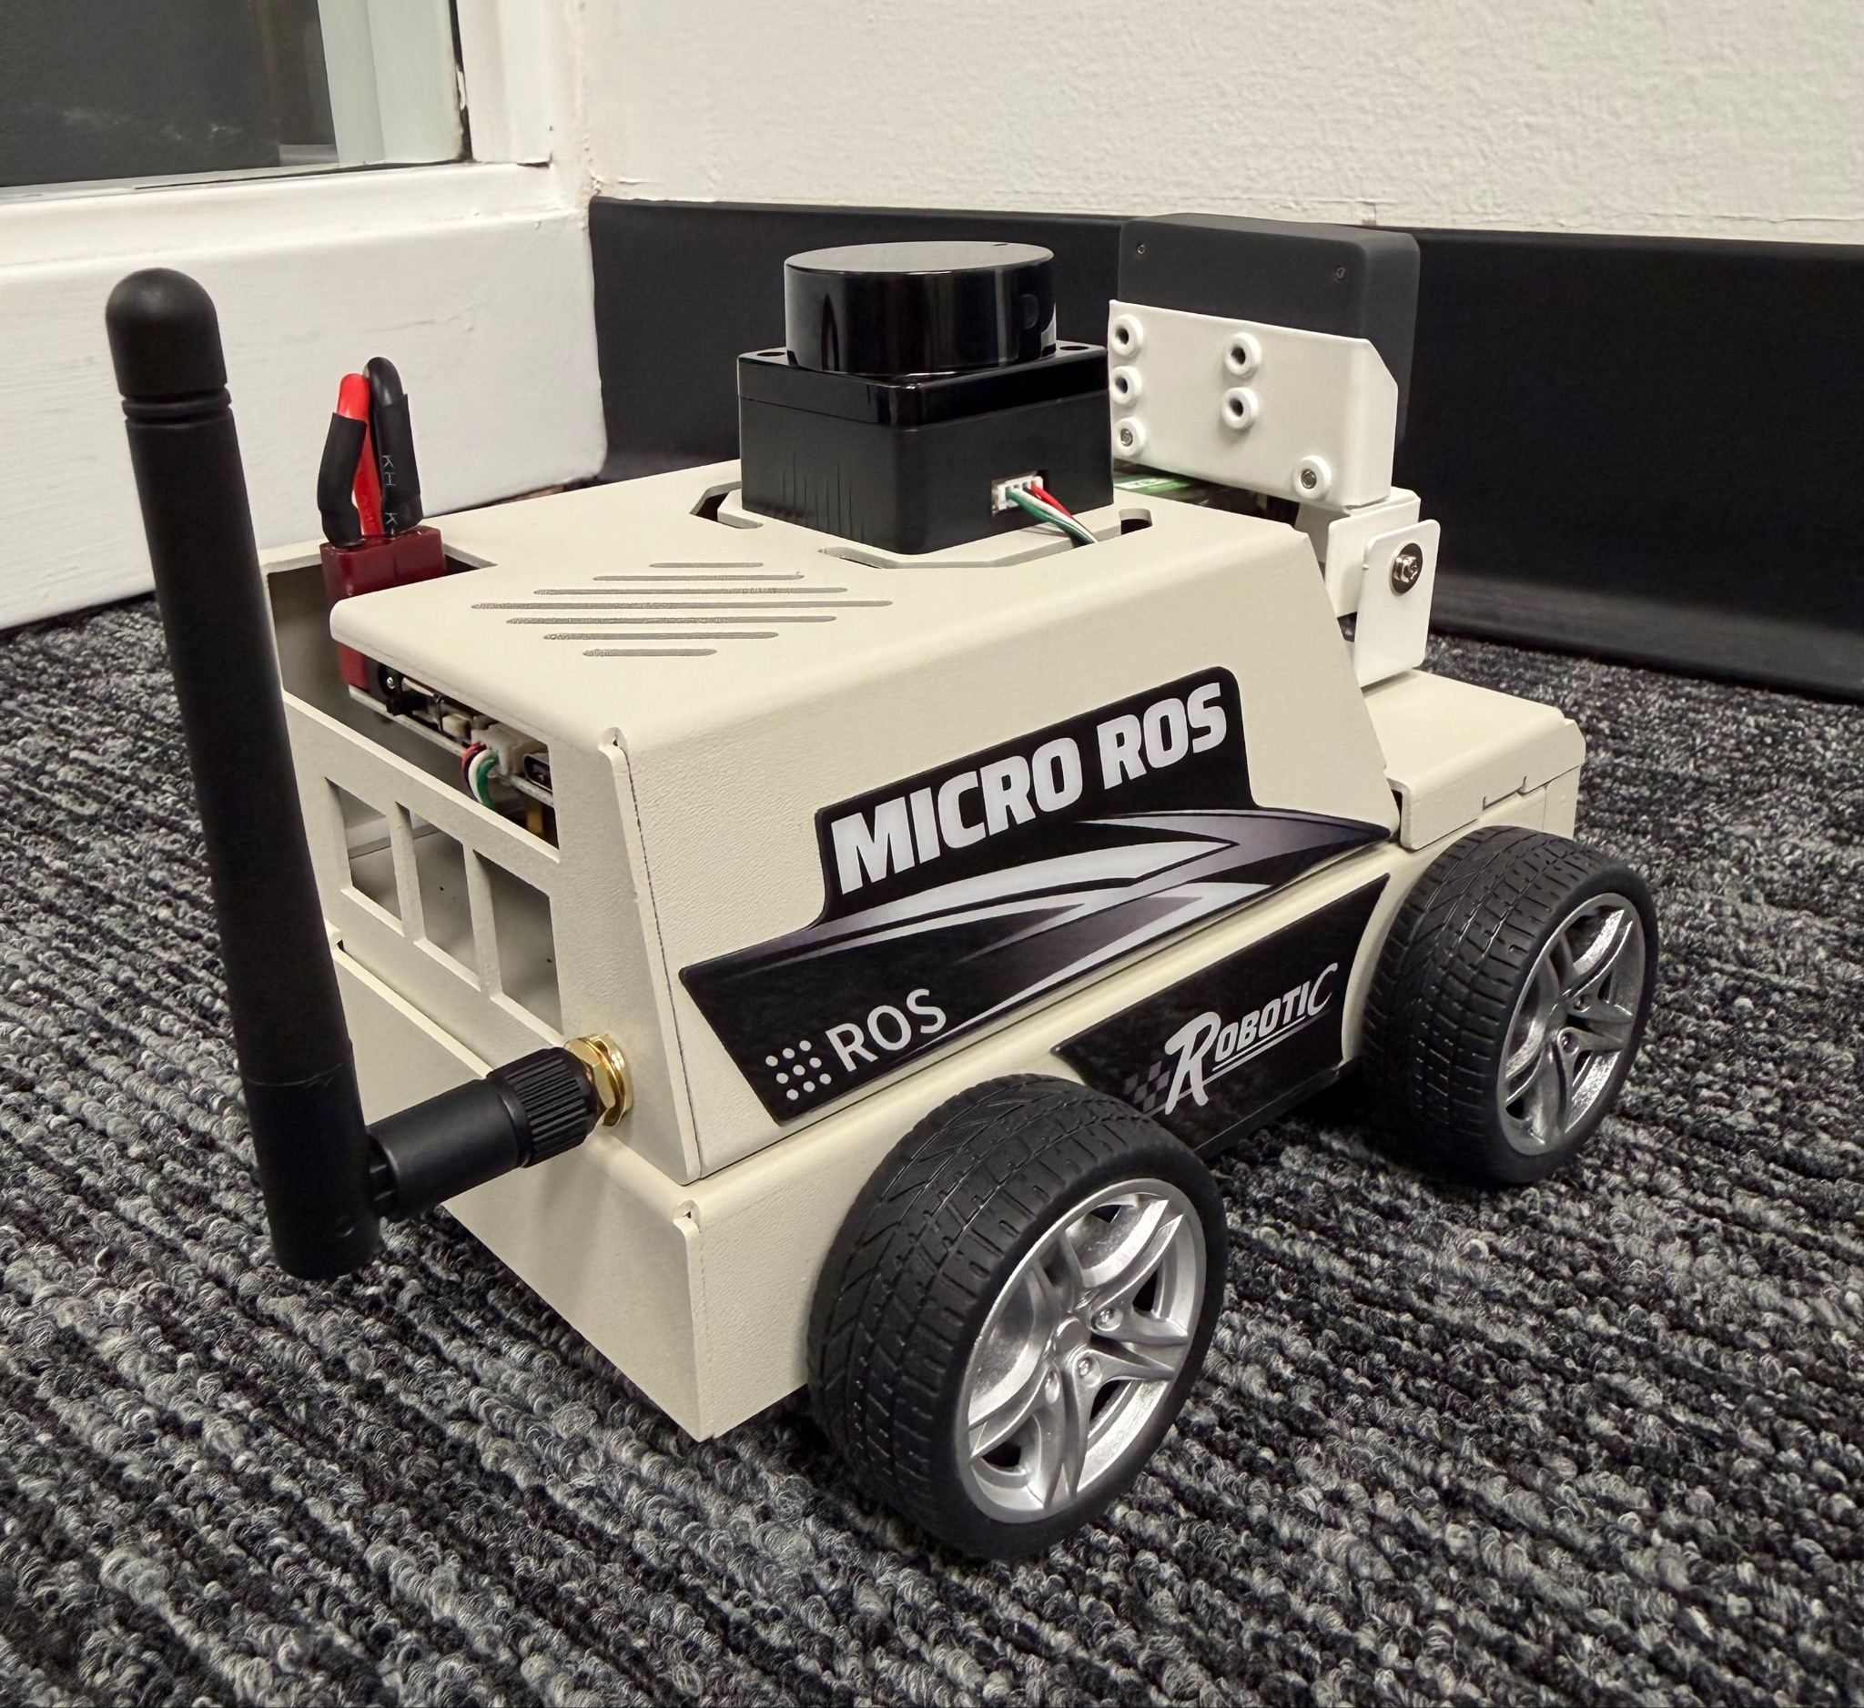
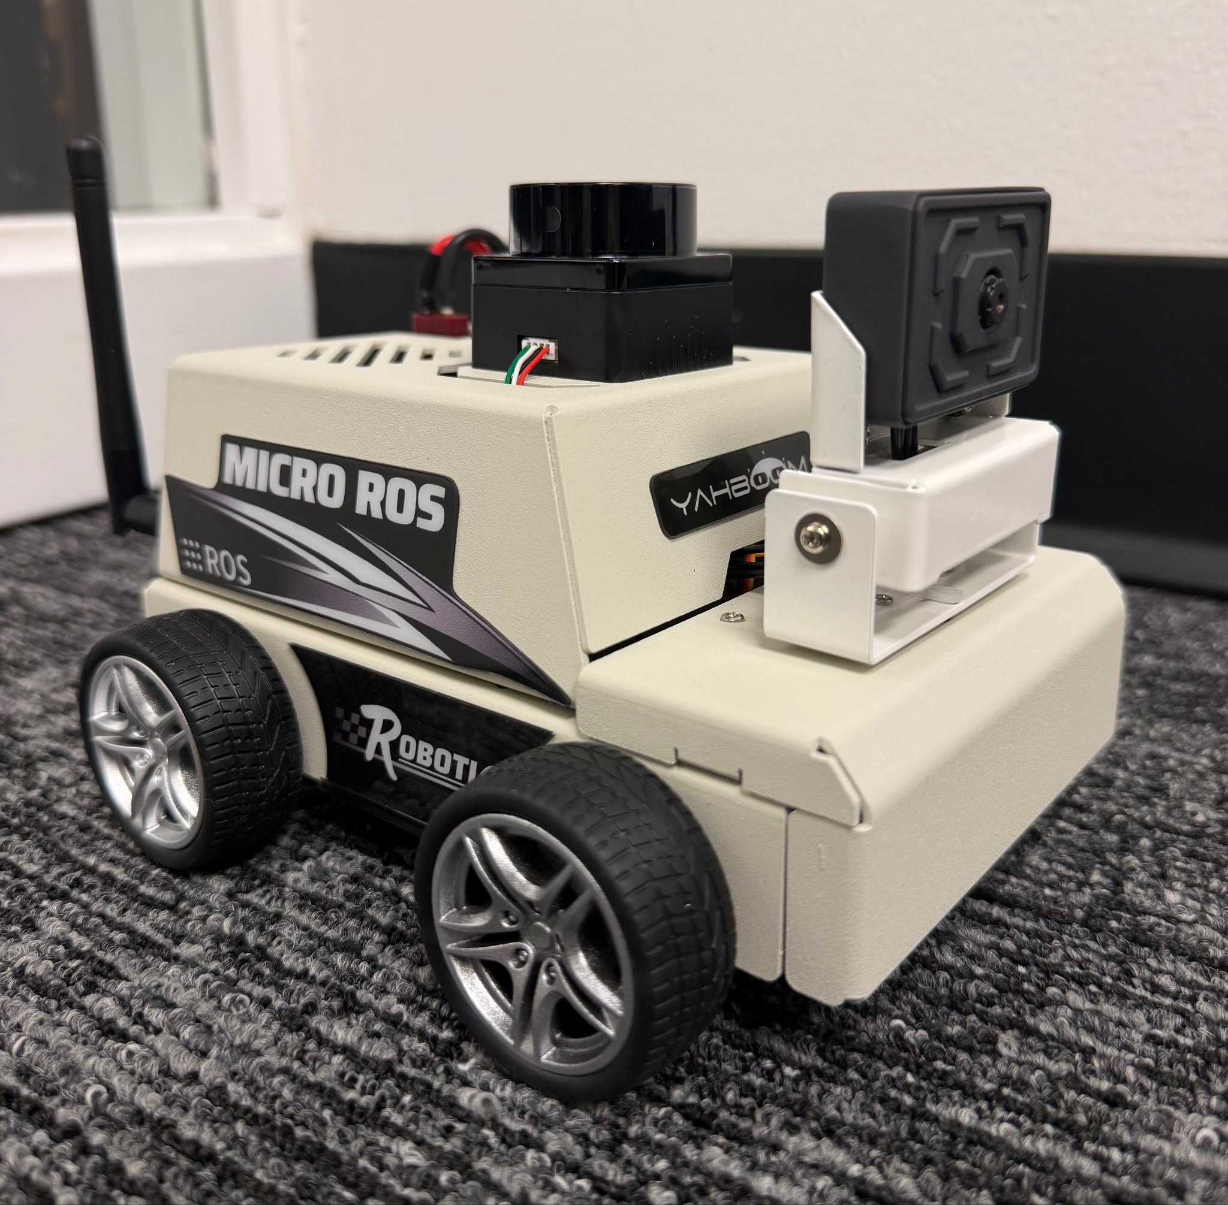
ROVER
WHAT IS IT?
The rover is a mobile unit designed to demonstrate autonomous decision-making on the lunar surface.
It navigates between objectives and charging stations using onboard sensors, ROS 2 communication, and micro-ROS firmware.
The system integrates both physical and simulated components for testing and data analysis.
CURRENT WORK:
ROS 2 ↔ micro-ROS communication working through USB passthrough
Rover responds to movement commands
ROS topics are now visible and updating from the ESP32 and Pi
NEXT STEPS:
Complete MQTT integration to send rover data to Unity
Integrate PyBaMM for energy-aware routing
Link rover state and movement with the Unity digital twin
Expand computer vision to support navigation tasks
Notes:
JULIE

Slide 7

PyBaMM AND TEDS
WHAT IS IT?:
PyBaMM stands for Python Battery Mathematical Modelling
It’s an open-source framework that simulates battery behavior using physics-based models
Built on electrochemical principles not just simple voltage vs. charge lookups
WHY IT MATTERS?:
Simulates real-time State of Charge (SoC), voltage, temperature, and health (SoH)
Predicts energy usage for different terrain types, slopes, and speeds
Helps plan feasible missions — ensuring the rover doesn’t die mid-route
Provides accurate charging profiles when connecting to stations
Enables energy-aware path planning (A* uses PyBaMM data to pick low-energy routes)
Notes:
SAM

Slide 8
DIGITAL TWIN
DIGITAL TWIN: A real-time virtual replica of a physical object, system, or a process
CURRENT WORK:
Obtained the 3D rover model and refined its components in Fusion360 and imported model into Unity
Fusion360: Design software from Autodesk used for design, simulation, and manufacturing
Unity: 2D and 3D game engine
Added Cesium for Unity to stream accurate lunar terrain into the digital twin environment
Developed a Unity movement script to prepare for syncing with the real rover
NEXT STEPS:
Connect the physical rover to the Unity digital twin
Using MQTT to publish rover data
Unity movement script updates the rover model to mirror real-time motion
Integrate Dreamscape (Rowan University)
Dreamscape is an immersive VR platform that combines cinematic storytelling with interactive coursework
Rowan opened its Dreamscape Learning Center includes advanced VR headsets, monitor sensors, fans systems to create a fully immersive experience
Allow us to visualize and interact with the lunar rover in a fully immersive 3D environment
Notes:
EMILY

Slide 9
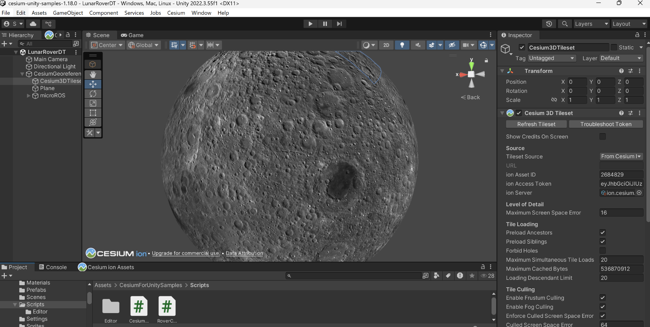
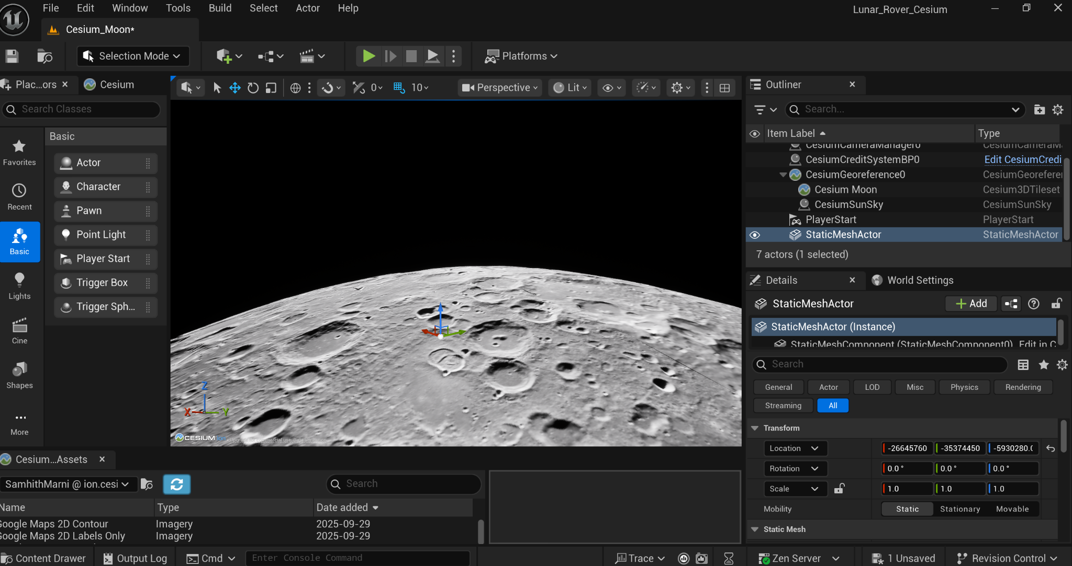
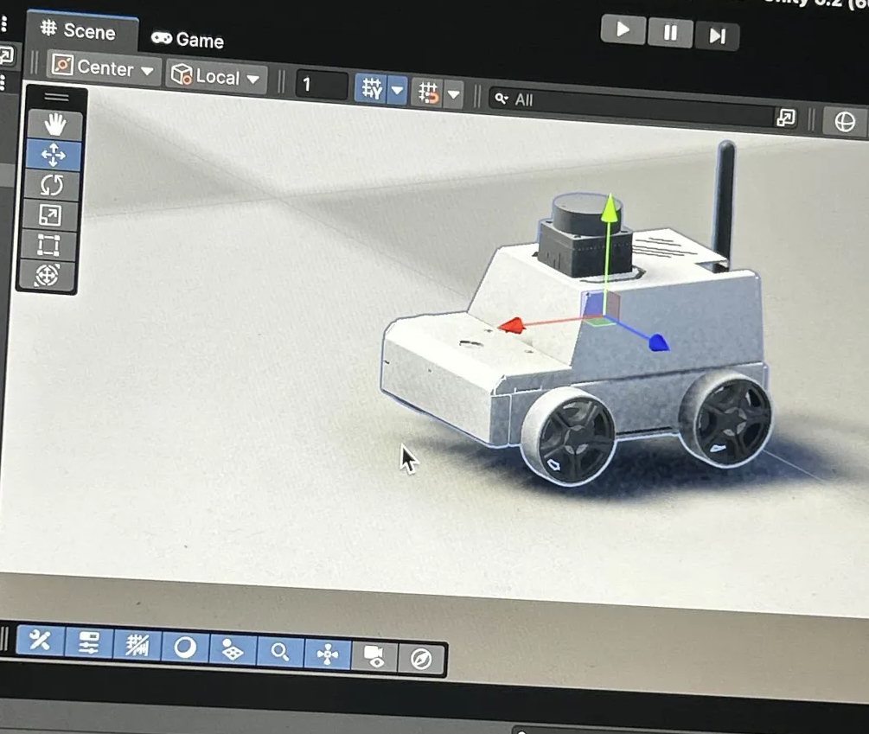
SNEAK PEEK INTO THE DIGITAL TWIN
Unreal Engine: game engine like unity
Notes:
SAM

Slide 10
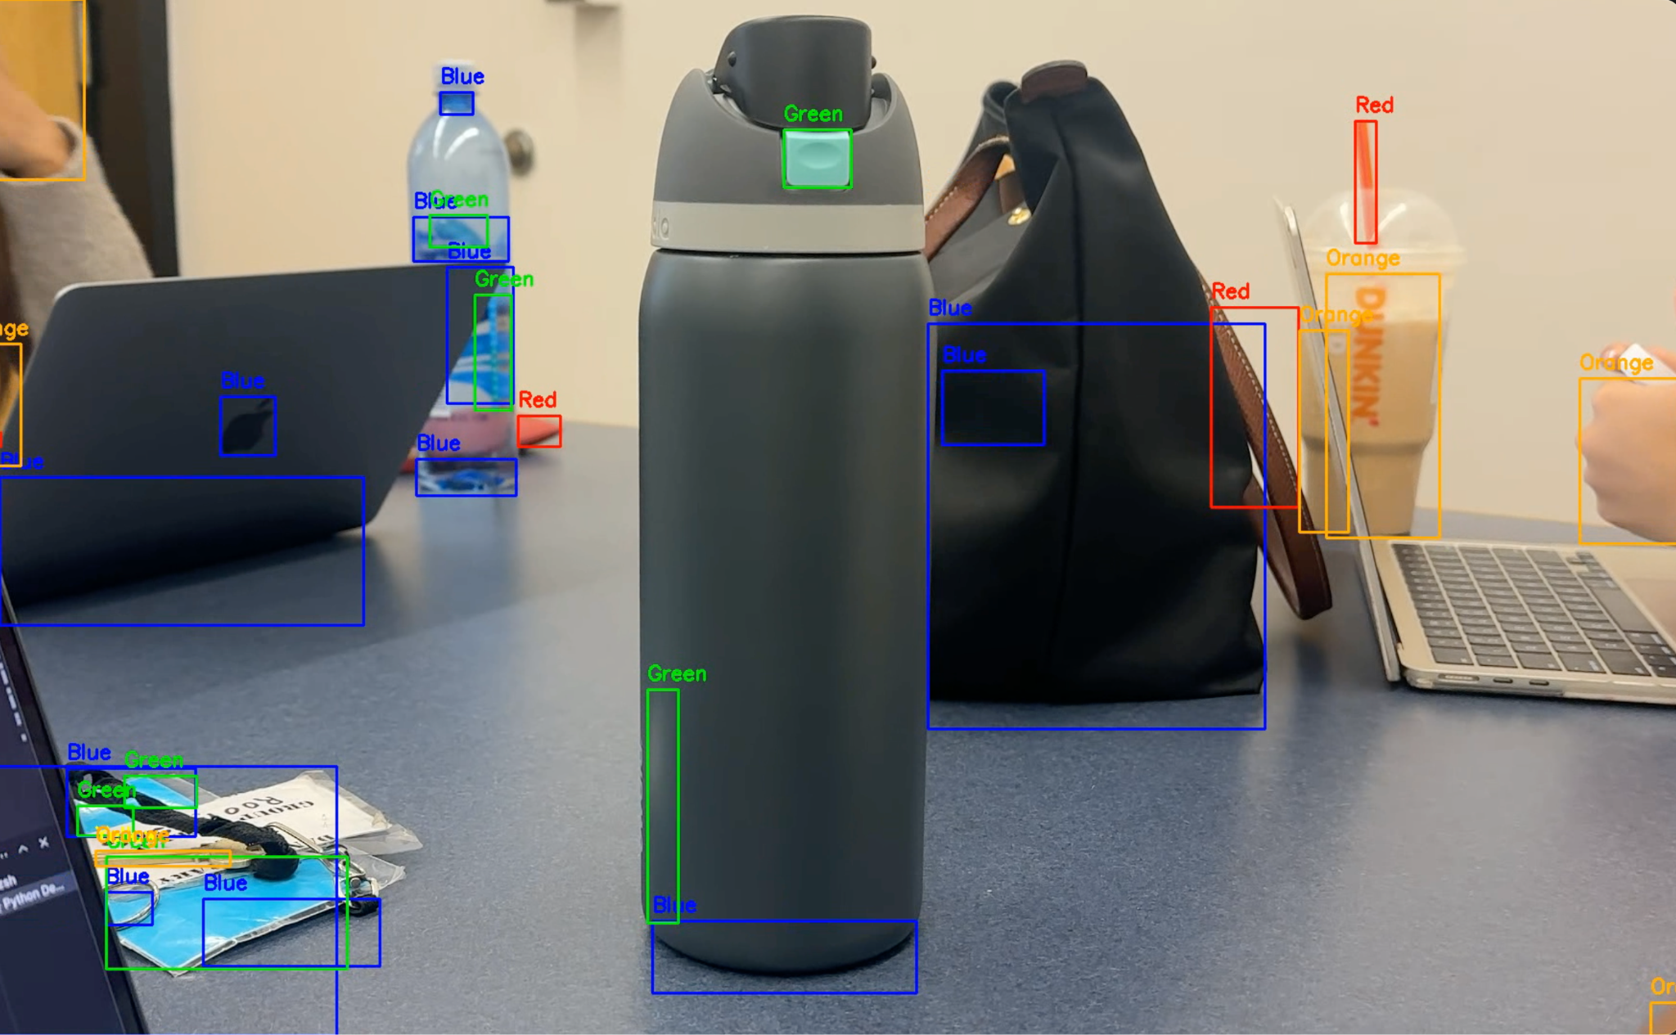
COMPUTER VISION
Battery stations and objectives will be marked with LED lights, making it necessary that the rover is able to identify the colors in its sight
Created color detection function using OpenCV Python library
Used masks to isolate pixels that fall between specific HSV ranges
Colors identified: red, blue, yellow, green, orange, and white
TO-DO:
Explore TinyML to enable overhead ESP32 microcontroller camera to split lunar surface into a coordinate grid with weights in each sector, informing rover of most efficient pathing.
Notes:
JAROD

Slide 11
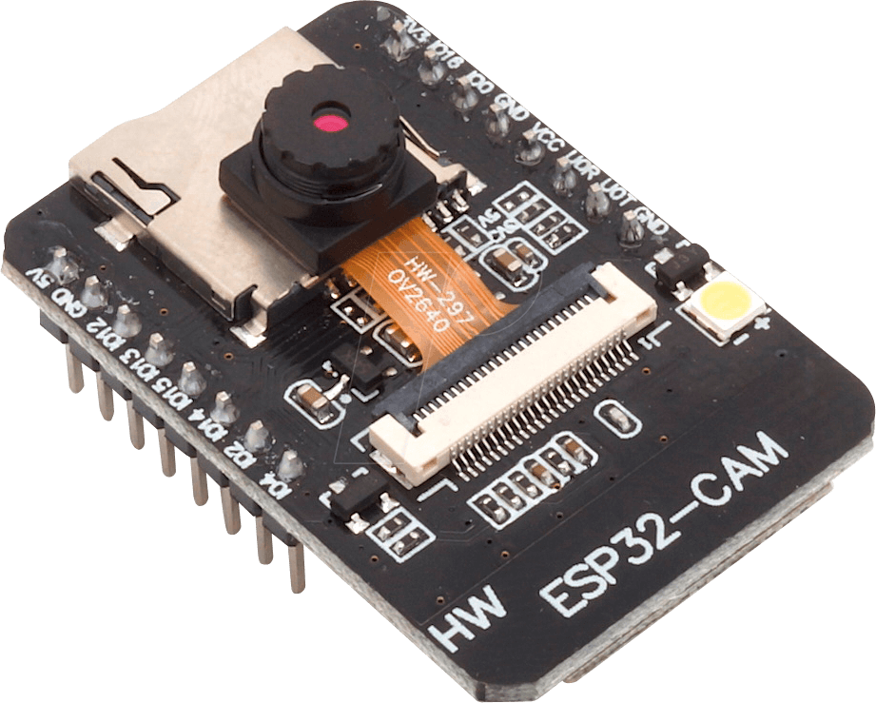
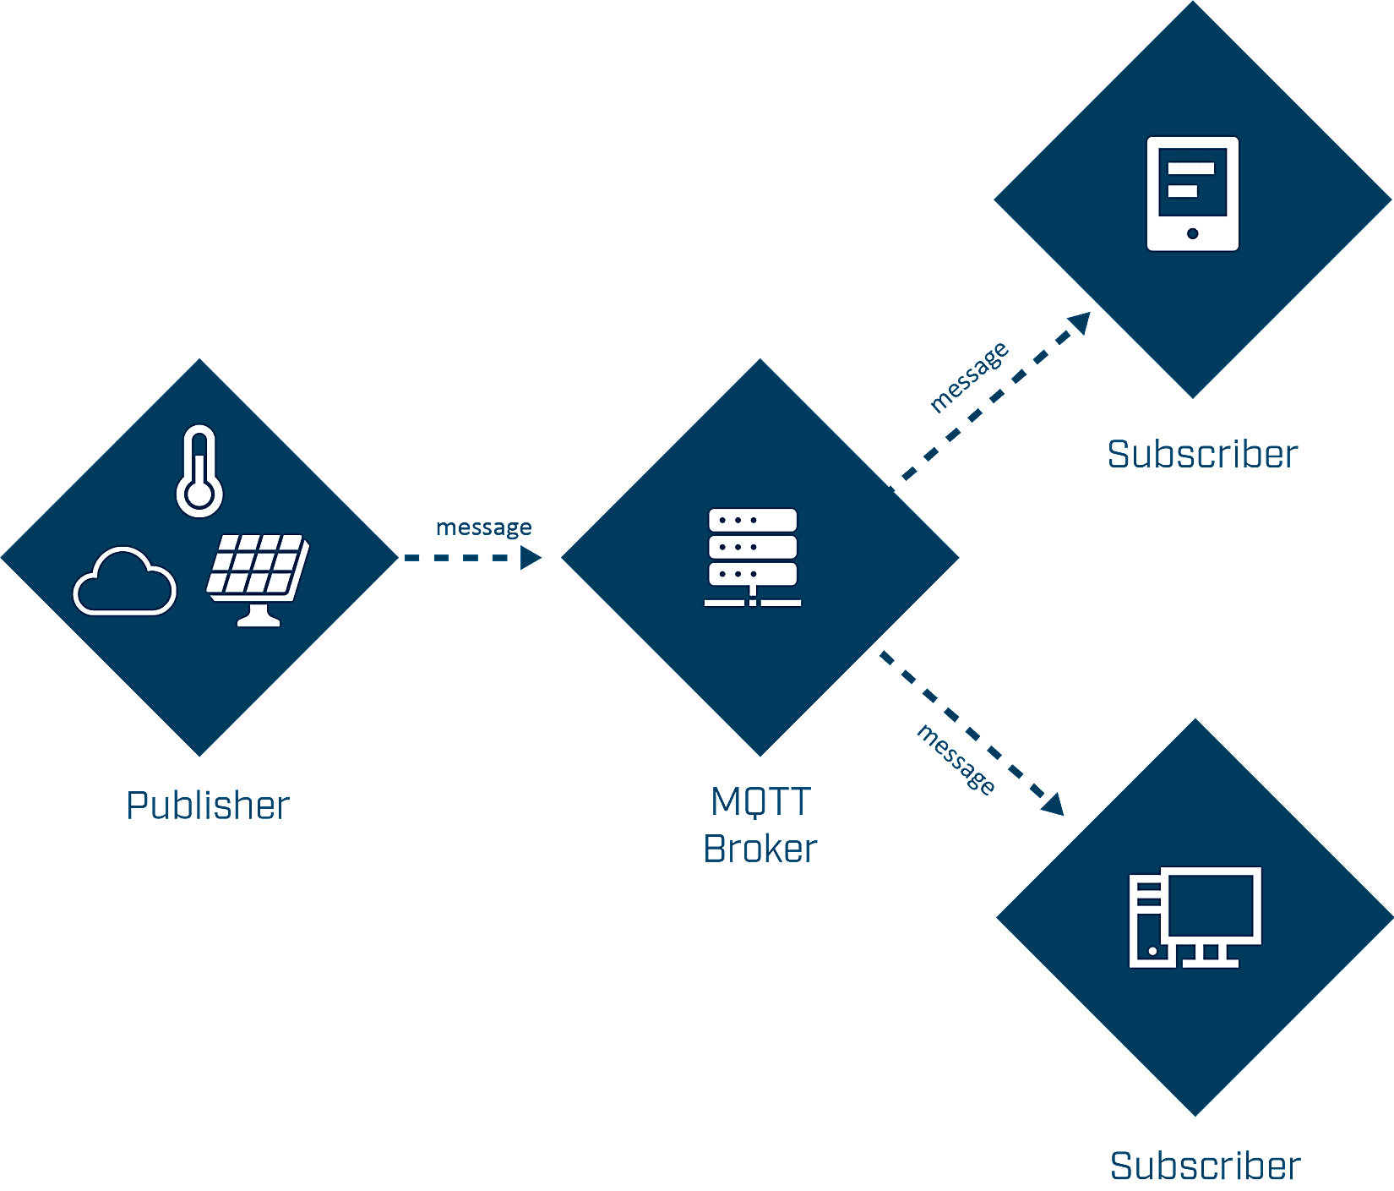
MQTT Broker Communication
An MQTT broker is an essential part of data communication in an Internet of Things system
Clients are able to subscribe to topics on the broker and receive messages published to that topic by other clients.
Information from objectives and battery stations (i.e. battery performance levels) need to be passed to the rover, so it can decide where to travel to next.
Work Done:
Coded ESP32 microcontroller to connect to WiFi, connect to MQTT broker on host device using serial monitor input, listen to a information request topic, and send JSON strings back to appropriate battery station topic
Coded in C++
Tested via Mosquitto (open source MQTT message broker service)

Slide 12
FUTURE WORK
PROGRESS: As of now, most milestones established in the Gantt chart have been met, and the project is on track for successful completion, setting a precedent for how autonomous operations on the lunar surface would look and be executed.
IMMEDIATE/UPCOMING MILESTONES:
Work on battery modeling and movement simulations
Develop pathfinding program
FURTHER MILESTONES:
Optimization of individual components
Complete system testing
Develop a user interface
Notes:
SAM

Slide 13
REFERENCES
IBM. “What is the Internet of Things (IoT)?” IBM, 16 Sept. 2025, www.ibm.com/think/
topics/internet-of-things
O’Hagan, Brian. “Lunar Command and Control Interoperability (LuCCI) Project Overview” Johnson Space Center, 13 Oct. 2025, https://ntrs.nasa.gov/citations/20240003016

Slide 14
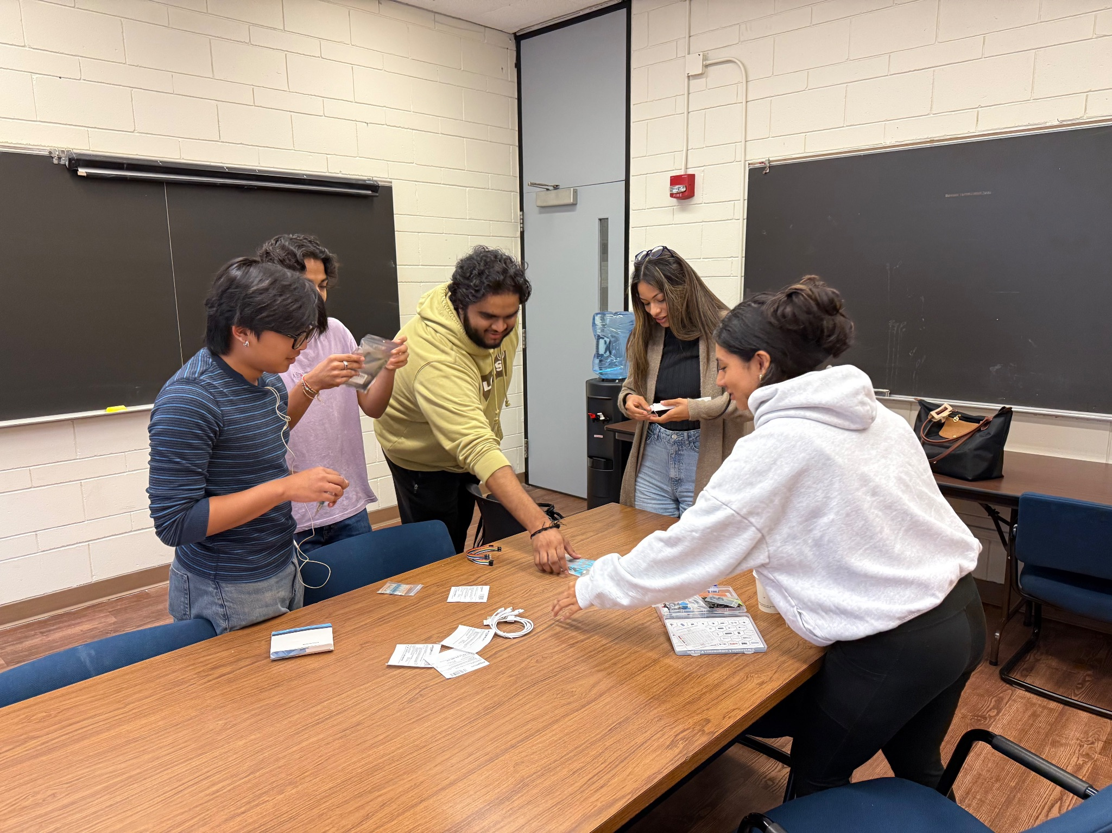
THANKS!
Notes:
Notes:
Why does this problem need to be addressed? / Business case (i.e. economics, support for individuals on the moon)
Mention collaboration between schools (Rowan team, Stennis, and each group’s roles)*Sam*
Add LUCCI slide / NASA’s efforts for lunar traversal
Mention Wi-Fi Halow (what it is and importance) and other new technologies
Are we on track? Have milestones been met? * Talk about on Gantt chart slide
Mention integration
Software engineering principles
Key takeaways thus far
Challenges faced (i.e. ROS configurations) *Julie*
Mention pybamm & teds *Sam*
Estimates for project completion success
Will there be a cloud server on the moon? (Things to talk about)
At the end, reemphasize the importance of the different project disciplines (implications of project success with real life situations)
Future work
Dreamscape *Emily* - to test digital twin, what it is for ✅
References

